Slide 2
PEC Bidding Documents and KPK PROCUREMNT RUELS-2014 Prof. Dr. Attaullah Shah

Slide 3
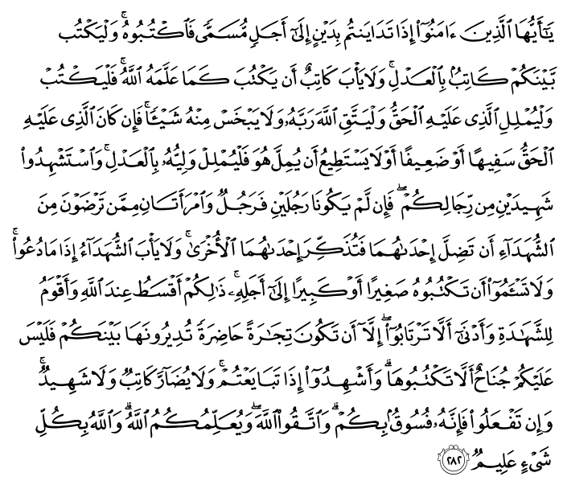
Quranic verse about contract

Slide 4
Translation
O you who have believed, when you contract a debt for a specified term:
write it down.
And let a scribe write [it] between you in justice.
Let no scribe refuse to write as Allah has taught him.
So let him write and let the one who has the obligation dictate.
And let him fear Allah , his Lord, and not leave anything out of it.
But if the one who has the obligation is of limited understanding or weak or unable to dictate himself, then let his guardian dictate in justice.
And bring to witness two witnesses from among your men.
And if there are not two men [available], then a man and two women from those whom you accept as witnesses - so that if one of the women errs, then the other can remind her.
And let not the witnesses refuse when they are called upon.
And do not be [too] weary to write it, whether it is small or large, for its [specified] term. ……………………………….

Slide 5
Some quotes about contracts
A verbal contract isn't worth the paper it's written on- Samuel Goldwyn Only free men can negotiate; prisoners cannot enter into contracts. Your freedom and mine cannot be separated- Nelson Mandela
Never contract friendship with a man that is not better than thyself- Confucius
The first principle of a civilized state is that the power is legitimate only when it is under contract. Walter Lippmann
It hurts a lot when you cannot really comprehend what a person is saying in a meeting, or you don't even understand what you're reading in your contract. Mary J. Blige
Marriage is not simply a romantic union between two people; it's also a political and economic contract of the highest order. Elizabeth Gilbert

Slide 6
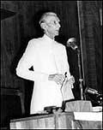
Address of Quaid-i-Azam Mohammad Ali Jinnah to the Constituent Assembly of Pakistan on his election as President of the Constituent Assembly of Pakistan (11th August 1947)
“One of the biggest curses from which India is suffering…is bribery and corruption. That really is a poison. We must put that down with an iron hand and I hope that you will take adequate measures as soon as it is possible for this Assembly to do so.”
In 2004, Pakistan with Transparency International CPI scores of 1.9, India with 2.9 and Bangladesh with 1.2 out of 10 are ranked in the lowest 50 countries amongst 141 countries.

Slide 7
CONTRACT
THE WORD CONTRACT IS DERIVED FROM LATIN WORD ‘CONTRACTUM’ WHICH MEANS DRAWN TOGETHER;
A contract may be defined as a voluntary agreement enforceable at law, made between two or more parties, whereby rights are acquired by one party to act or forbearances by the other.
According to the Construction Specification Institute (CSI) Manual of Practice, a contract is “a promise or a set of promises for the breach of which the law gives a remedy of the performance of which the law recognizes a duty” (CSI 2008).
The agreement is reached by the acceptance of an offer made by one party to do something for other for a stipulated consideration.

Slide 8
ELEMENTS OF A CONTRACT
These are the five basic elements of a contract
OFFER
CONSIDERATION
ACCEPTANCE
LEGAL PURPOSE
LEGAL CAPACITY

Slide 9
Construction Contract Documents
Characteristics of a “good” contract document:
Carefully considered
Expressed clearly
Time-tested
Comprehensive
Fair
Balanced
Applicable to the elements of a projects

Slide 10
PEC BIDDING DOCUMENTS
Standard Form of Bidding Documents (Civil Works)
(to be used for estimated value of more than Rs. 25 Millions)
Standard Form of Bidding Documents for Procurement of Works (E&M)
(to be used for estimated value of more than Rs. 25 Millions)
Standard Form of Bidding Documents for Procurement of Works
(For Smaller Contracts)
(to be used for all type of procurement for estimated value of not more than Rs. 25 Millions)
Standard Form of Contract for Engineering Consultancy Services
(For Large Projects) – Time Based Assignments
(to be used for consultancy fee over Rs. 2 Millions)
Standard Form of Contract for Engineering Consultancy Services
(For Large Projects) – Lump Sum Assignments- to be used for consultancy fee over Rs. 2 Millions)
Standard Form of Contract For Engineering Consultancy Services
(For Smaller Projects)
(to be used for consultancy fee not more than Rs. 2 Millions)

Slide 11
Methods of procurement
Single Stage – One Envelope Procedure
This method should be used where cost is the only determining factor
Main open competitive bidding procedure used for most of the procurement of goods, works and services
No technical complexity or innovation
Single Stage – Two Envelope Procedure.
Technical and Financial Proposals separately at one stage
Bids are to be evaluated on technical and financial grounds and price is taken into account after technical evaluation.

Slide 12
Two Stage Bidding Procedure
In case of procurement of complex or specialized goods either of the two methods may be adopted,
Pre-qualification of prospective bidders and invitation of bids from the pre-qualified bidders; and
Through single envelope two stage method post-qualification-
in the first stage technical proposal and the technical proposals will be evaluated in accordance with the evaluation criteria set forth in the bid solicitation document.
A list of qualified and unqualified bidders will be formulated at the end of first stage;
Financial proposals will be solicited from qualified bidders in the second stage.
The lowest offer from the qualified bidder shall be accepted for award of the contract and will be the best evaluated bid.

Slide 13
Pre-qualification of Suppliers and Contractors
In case of contracts for large and complex works and services
Turnkey, design and build, or management contract;
Expensive and technically complex equipment and works
Drugs and services of complex nature.
Criterion for pre-qualification ( For works exceeding 45 Million or complex in nature
Experience and past performance
Capabilities with reference to finance, HR and Equipment
Other related capabilities
Pre-qualification process:
Invitation in the News Paper
Provide a set of pre-qualification documents
All applicants having the capacity to be prequalified
Verification of documents/information
Prompt information to the applicants about decision
On written request may provide reasons for not prequalifying

Slide 14
Open tendering post-qualification
In case of contracts of complex nature and valuing Rs. 15 million or above. ( For works 2.5-45 Million)
Requirement of post-qualification given in solicitation documents.
Post-qualification may be undertaken in accordance with the provision of these rules, regardless of the bidders being pre-qualified.
Prior to recommending contract award;
Offered to the best evaluated bid
If the best evaluated bid has not satisfied the criteria during the post qualification, then the next best evaluated bid may be checked and so on, till the criteria is fulfilled

Slide 15
Alternate methods for procurement of goods
Single quotation upto Rs 50,000
Petty purchases between Rs. 50,000/- upto Rs. 100,000/ through quotations
Direct Contracting
Where civil works are to be contracted and are a natural extension of an earlier or ongoing job
Same contractor will be more economical and will ensure compatibility of results in terms of quality of works subject to limitation of repeat or variation order;
Where a change of contractor or supplier would oblige the procuring entity to acquire material having different technical specifications
In case of emergency as defined in these rules and procurement
Variation order to a contractor to include works which were outside the original scope of works to ensure interests of Government and for reasons of economy, compatibility and efficiency provided that

Slide 16
CASE STUDY
TECHNICAL AND FINANCIAL EVALUATION OF PROPOSALS FOR
Provision of Solar Home Systems at Different Villages Cities of Balochistan
Sr. # | Evaluation Creteria | Max. Marks | M/s A | M/s B | M/s C | M/s D | M/s E | M/s F | M/s G | M/s H
 |  |  | Marks Obtained
1 | Understanding and comments on TORs | 10 | 5 | 7 | 2 | 3 | 2 | 8 | 8 | 8
2 | Quality of staff | 10 | 5 | 7 | 5 | 4 | 0 | 8 | 7 | 7
3 | Financial stability-Bank Statement for the last three years to be attached. | 10 | 6 | 7 | 5 | 0 | 0 | 8 | 7 | 7
4 | Previous experience in similar Solar projects of last Three (03) years | 10 | 0 | 7 | 2 | 2 | 0 | 9 | 7 | 7
5 | Operation and Maintenance strategy | 5 | 3 | 3 | 0 | 2 | 0 | 3 | 3 | 3
6 | User information strategy | 5 | 0 | 3 | 0 | 0 | 0 | 3 | 3 | 3
7 | PV Panel | 10 | 7 | 8 | 0 | 0 | 5 | 8 | 8 | 8
8 | Charge Controller | 10 | 8 | 8 | 0 | 0 | 5 | 8 | 8 | 8
9 | Battery | 10 | 8 | 8 | 0 | 0 | 5 | 8 | 8 | 8
10 | Wiring and installation | 10 | 5 | 6 | 0 | 0 | 0 | 6 | 6 | 6
11 | Quality of the project management plan | 10 | 0 | 6 | 0 | 0 | 0 | 7 | 6 | 6
 | Passing Marks (70 Marks) | 100 | 47 | 70 | 14 | 11 | 17 | 76 | 71 | 71
 | Total - A (Technical Weightage) | 80% | 37.60 | 56.00 | 11.20 | 8.80 | 13.60 | 60.80 | 56.80 | 56.80
Total - B (Financial Weightage) |  | 20% | 0.00 | 20.00 | 0.00 | 0.00 | 0.00 | 17.79 | 16.87 | 16.52
Grand Total |  | 100% | 37.60 | 76.00 | 11.20 | 8.80 | 13.60 | 78.59 | 73.67 | 73.32
 | The Bid Evaluation Committee approved the Bid of M/s F at an amount of Rs.13,512,801/- (Rupees Thirteen Million Five Hundred Twelve Thousand Eight Hundred One Only)

Slide 17
Least cost selection
PROCURING CONSULTING SERVICES
Least cost (selection):-
This method will only be used for assignments of standard or routine nature, where well established practices and standards exist;
Procedures for selection under least cost selection:
Following evaluation of technical proposals and opening of financial proposals, the applicant offering the lowest evaluated price shall be selected for discussions on technical issues if deemed necessary; and
b) under this method proposals passing the technical score threshold shall then be treated equally and evaluated on the basis of cost only.

Slide 18
LCS is only appropriate for selecting consultants for very small assignments, of a standard or routine nature where well-established practices and standards exist.
The RFP shall define the “minimum” qualifying mark for the “quality” and request the firms to submit at the same time technical and financial proposals in separate envelopes.
Technical proposals will be opened first and evaluated. Those securing less than the minimum qualifying mark will be rejected, and the financial proposals of the rest will be opened in public.

Slide 19
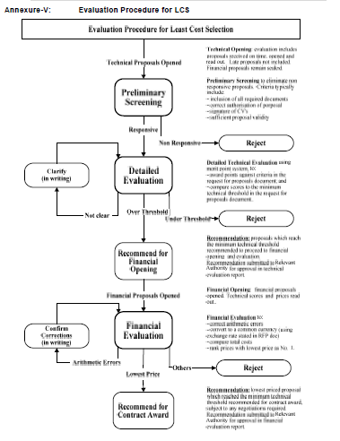

Slide 20
Methods for Selection of Consultants/Consulting Firms
Quality based selection
Quality based selection:-
for highly specialized and complex assignments, where quality is the only factor
Procuring agency d shall record its reasons and justifications
Procedures for selection under the quality based selection:
a) A request for expression of interest as laid down is advertised to invite interested applicants or firms to contest;
b) A request for proposals shall be prepared and sent to short-listed consultants selected
Following the laid down criteria;
i) the evaluation of proposals shall be carried out in two stages in the following manner, namely: i)the technical proposals shall be evaluated and the procuring agency may discuss technical details, if it may deem necessary;
ii) The financial proposals of technically responsive or highest ranked proposal only shall be opened in the presence of the applicants or their representatives who may wish to attend the opening session; and
iii) Highest ranked proposal is accepted, if it suits to the procuring agency in all respects.

Slide 21
Procedures for selection under the quality based selection:
a) A request for expression of interest as laid down under regulation 5 is advertised to invite interested applicants or firms to contest;
b) A request for proposals shall be prepared and sent to short-listed consultants selected
Following the laid down criteria;
i) the evaluation of proposals shall be carried out in two stages in the following manner, namely: i)the technical proposals shall be evaluated and the procuring agency may discuss technical details, if it may deem necessary;
ii) The financial proposals of technically responsive or highest ranked proposal only shall be opened in the presence of the applicants or their representatives who may wish to attend the opening session; and
iii) Highest ranked proposal is accepted, if it suits to the procuring agency in all respects.

Slide 22
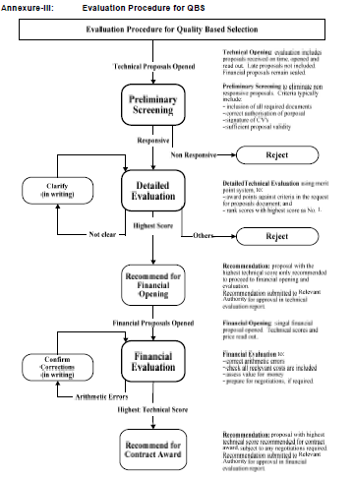

Slide 23
QBS is appropriate when:
Assignments are complex or highly specialized making it difficult to define precise TORs and the required input from the consultants;
Assignments where the downstream impact is so large that the quality of the services is of overriding importance for the outcome of the project; and
Assignments that can be carried out in substantially different ways such that financial proposals may be difficult to compare.

Slide 24
Quality and cost based selection
i. This method shall be used where high quality is the prime consideration while cost is a secondary consideration;
ii. Procedures for Selection under the Quality and Cost Based Selection (QCBS).
a) A Request for Expression of Interest (EOI) as laid down is advertised to invite interested applicants/firms to contest
b) A Request for Proposals (RFP) shall be prepared and sent to short-listed consultants selected following the laid down criteria;
c) The evaluation of proposals shall be carried out in two (2) stages in the following manner: i) the Technical Proposals shall be evaluated and the procuring agency may discuss technical details, if deem necessary; ii) the financial proposals of technically responsive proposals shall be opened in the presence of the applicants or their representatives who may wish to attend the opening session; and iii) a combined evaluation of technical and financial proposals shall follow and the applicant with the winning proposal will be accepted.

Slide 25
QCBS will be used where high quality is the prime consideration while cost is a secondary consideration. Since under QCBS the cost of the proposed services is a factor in the selection, this method is appropriate when:
i. The scope of work can be precisely defined;
ii. The TOR are well specified and clear; and
iii. the procuring agency and the consultants can estimate with reasonable precision the personnel time as well as the other inputs required of the consultants.

Slide 26
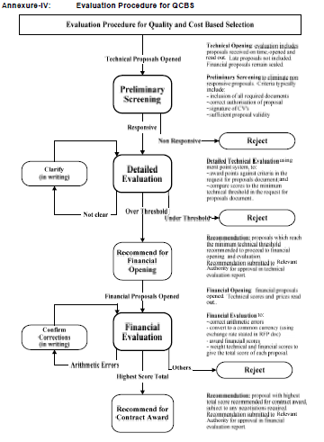

Slide 27
Single source or direct selection
Single source or direct selection:
i. This method will be used only in exceptional cases, where it provides clear advantage over competition in following cases (only), namely:-
a) for tasks which are natural continuation of previous assignment and where continuity of technical services is unavoidable;
b) Repeat orders
c) in cases of emergency
d) where only one consultant is qualified or has experience of exceptional worth

Slide 28
Procedures for selection under single source selection:-
a) the justification for single source selection method shall be examined therefore, the decision to use the single source selection method shall be approved in writing by the principal accounting officer/HoD, concerned on recommendation by a Committee; and
b) The request for proposals or TOR, as the case may be, shall be issued to the selected consultant and the selected consultant shall be requested to submit a technical and financial proposal upon the receipt of which discussions shall be held between the proposal evaluation committee and the selected consultant and all aspects of its proposal, whether technical or financial, shall be discussed together in order to reach an agreement/contract etc.

Slide 29
Fixed Budget
Assignment is simple;
Can be precisely defined; and
Budget is fixed;
The Request for Proposal shall indicate the available budget. Proposals that exceed the indicated budget shall be rejected; and
The ranking shall be based only on evaluation of technical proposals of the qualified bidders.
Design Contest.—
This method shall be used only for projects where aesthetic component is of prime consideration.
The Procuring Agency shall invite consultants to submit a financial proposal and present a plan or design for the project based on a concept or criteria provided by it.
The financial proposal of the top-ranked consultant shall only be opened.

Slide 30
“TOR, Evaluation and Award of Consultancy Contracts”

Slide 31
Introduction:
Terms of Reference (TOR) is the document to be prepared by the client for:
Scope of services for the consultants
Estimation of consultant’s inputs
Proposed costs of services
Methods of selection of the consultants
Standard forms of conditions of consultancy contract
Various forms for making proposals and contracts

Slide 32
Introduction:
TOR documents for consultancy contracts are synonymous to bidding documents for construction contracts
TOR documents to seek Technical and Financial proposals from the consultants
Although preparation of TOR is clients activities, however, understanding by the consultants such activities is imperative for correct analysis, conforming to regulations

Slide 33
Introduction:
Appropriate analysis of TOR by the consultants will facilitate consultants to avoid post proposal disadvantages and loss of projects
Knowledge of pre-qualifications and consulting regulations stipulated by the PEC is essential
TOR should be prepared and proposals thereon to be made by the experienced staff

Slide 34
Introduction:
TOR and proposal making should involve both contractual and management staffs having requisite knowledge of the relevant projects
Client may hire consultants for preparation of TOR, but such consultants are debarred for making proposals for such project

Slide 35
Contents of a TOR:
Project Background:
It’s role in the project
History and location
Issues to be resolved
Source of financing
Objectives
Determination of project feasibility
Design of structures
Procurement documentation
Construction and completion of projects
Training programme

Slide 36
Contents of a TOR:
Scope of services
Phasing of tasks
Data collection
Environmental Impact Assessment (EIA)
Survey & investigation
Design
Procurement
Supervision

Slide 37
Contents of a TOR:
Requirement of Expertise
Scoring weight ages for technical proposals
Team responsibilities requirements
Association/joint venture issues
Technological or institutional experience
Training and skills transfer
Training of (Implementing Agency) IA personnel
Training of counterpart personnel
Training through job
Training through institutions

Slide 38
Contents of a TOR:
Institutional Arrangements
Project management organization
Consultants resident engineer
Status of client’s personnel
Consultant’s responsibilities for project completion
Selection of staff and handling of unsuitable staff
Reporting Requirements
Periodic Progress Report
Inception Report
Interim Report
Final Report

Slide 39
Estimation of Input/Costs:
Estimation of Time Inputs
Activity schedule
Staffing Schedule
Estimation of Cost Input
Salary cost
Social charges
Overhead costs
Fee
Director (Non-Salary Cost)
Contingencies

Slide 40
Billing Rate:
Items Description Units
a - Salary cost (including Social costs) 100
b - Overhead (say 90% of ‘a’) 90
c - Salary cost + overhead cost 190
d - Fee (say @ 12% of ‘c’) 22.80
e - Billing rate (c+d) 212.80

Slide 41
Letter of Invitation:
System of Selection
Quality Based Selection (QBS)
Quality and Cost Based Selection (QBCS)
Weightage Assignment Aspects
Technical Aspects
Financial Aspects
Instruction for Preparation of Proposals
Technical Proposal : Form 1 to 9 (Appendix-I)
Financial Proposal : Form 1 to 6 (Appendix-II)

Slide 42
Weightage for Main Items for Various Types of Assignment: Total Points = 100
Type of Assignment | Specific Experience of the Firm | Work Plan/ Methodology | Competence of Key Personnel | Suitability for Training (when Training is part of the Assignment
1. Pre Investment | 10 | 30 | 55 | 5
2. Preparation Design, Tender Documents, Prequalification, Tendering Award | 35 | 30 | 30 | 5
3. Supervision of Construction etc. | 5 | 20 | 70 | 5
4. Training | 10 | 10 | 80 | -
5. All Four Phases Listed above part of Assignment | 10 | 25 | 60 | 5

Slide 43
“Evaluation of Proposals and Award of Consultancy Contracts

Slide 44
Introduction:
Defining Engineering Services:
Proposal is the offer by a consultant
Proposal is used in the meaning of bid
Evaluation and Award are most important but often suffers from controversies
Proposal is a price and conditions at which a proposer intends to supply engineering services to a Client

Slide 45
Introduction:
Proposal is submitted on the basis of Request for Proposal (RFP) documents prepared and supplied by client for purchase of specific services
Pre-qualification of consultants is not mandatory, however, recommended specially for major projects
“PEC Procedure for Pre-qualification of Consultants” to be followed for pre-qualifying the consultants

Slide 46
Introduction:
Following documents are relevant for evaluation and award:
Conduct & Practice of Consulting Engineers Bye-laws 1986
PEC Standard Procedure for Evaluation of Proposal for Procurement of Engineering Services
Public Procurement Rules 2004/BPPRA-2014
PPRA rules deficient to address evaluation and award of consultants proposals
PEC and PPRA have harmonized the PEC documents on August 31, 2006

Slide 47
Method of Evaluation:
ToR must reflect the provisions of intended method of evaluation
PEC Procedure envisaged two methods of evaluation:
Quality Based System QBS
Quality Cum Cost Based System QCBS
In QBS consultants are ranked solely on the basis of their technical proposal
In QCBS consultants are ranked in order of weighted evaluation awarding 80-100 percent for technical proposal and 0-20 percent for financial proposal

Slide 48
Appendix A-Professional Charges:
Remuneration of service by any one or combination thereof by prescribed nine methods
Cost Plus fixed fee and fixed lump sum Payment are two widely used methods
PEC Guidelines highlighted these two methods
Remuneration include (a) Salary Costs, (b) Overhead Costs, © Direct Non Salary Costs and (d) Fixed Fee (to be negotiated)
Three components are well defined but not the fee

Slide 49
Method of Evaluation:
Generally Single Stage two envelope system apply containing
Technical Proposal
Financial Proposal

Slide 50
Steps in QBS:
Formation of evaluation Committee
Receipt of Proposals in two envelopes
Evaluation of Technical Proposals as regards to:
Understanding of project need
Methodology
Work Plan
Time Schedule
Personnel Qualification
Rank the consultants in order of technical score received

Slide 51
Steps in QBS:
Technical and Financial criteria shall be part of the ToR
Public opening of financial proposals of three top ranking consultants in their presence
Top ranking consultant first be invited to negotiate contract with client
“Negotiations” means adjustments in ToR and not cost reduction to other consultants costs

Slide 52
Steps in QBS:
Failed agreement will be notified explaining points of disagreement
A similar exercise will then be carried out with second ranked consultant
In case of failure for all the three, above procedure shall be repeated for next three consultants

Slide 53
Steps in QCBS:
Ranked the consultants for technical score as before
Publically open the financial proposals for top three firms
Make weighted evaluation following Section 5.9 of PEC Procedure
Award to highest ranked consultant in weighted evaluation

Slide 54
Selection Process:
Engineering Services to only registered consultants (SS-1)
Foreign consultants in a joint venture in the ratio of expertise not available in Pakistan (SS-2)
Independent foreign consultants permissible with prior PEC approval for short assignment on Technology Transfer Agreements
All work is entrusted only to Pakistani consulting engineers except when conditions in SS-2 are fulfilled (SS-3(b))

Slide 55
Selection Process:
Engineers proposed in proposal should be on the rolls of the consultants (SS-3(b))
Award on technical competency and not only on financial proposal
Professional fee on the basis of Appendix-A (SS-3(g))
Selection through open competition- no consideration of being in public sector (SS-3(h))

Slide 56
Selection Procedure:
Invitation of pre-qualification application except Technical Assistance (SS-1)
Two envelope proposals from Pre-qualified consultants (SS-2)
Qualified Committee to evaluate proposals – quality based ranking for project understanding, methodology, work plan, time schedule, experience and qualifications of personnel, present work load and other pertinent aspects (SS-3)
Open financial of technically top three (SS-4)
Technically top ranking consultant will first be invited for negotiation……(SS-5)
[least cost syndrome – a foul play]

Slide 57
Evaluation of Proposals:
PEC Procedure for Evaluation of Proposals provides as under:
Two methods – QBS or QCBS
For QCBS Technical Weightage is 80-100% & Financial Weightage is 0-20%
Recommended allocations of points:
Experience of consultants [05-10]
Work plan & methodology [10-30]
Qualification & experience of staff [30-60]
Transfer of knowledge [ 0-05]
Total Points: 100

Slide 58
Evaluation of Proposals:
Sub-criteria of key staff:
Academic qualifications [20-30]
Related project experience [50-60]
Knowledge of language [0-5]
Duration with firm [0-5]
Total points: 100
Minimum qualifying technical score - 70

Slide 59
Evaluation of Proposals – QCBS:
Consultants | Technical Score | X 80% | Price Pak Rs. In Million | LPx100 P Score | X 20% | Weightage 80/20
A B C | 87 83 80 | 69.6 66.4 64.0 | 6.2 4.5 4.2 | 67.7 93.3 100.0 | 13.5 18.7 20.00 | 83.1 85.1* 84.0
Source: PEC procedure for Evaluating Proposals

Slide 60
Award of Contract:
PPRA Rules 2004 (applicable for Federal Government Procurement)
Client to inform all proposers evaluation results 10 days prior to award (Rule-35)
No negotiation to lower Price (Rule-40), except under Rule-42
Award to top ranked consultant following PEC procedure

Slide 61
THANK YOU

